Slide 1
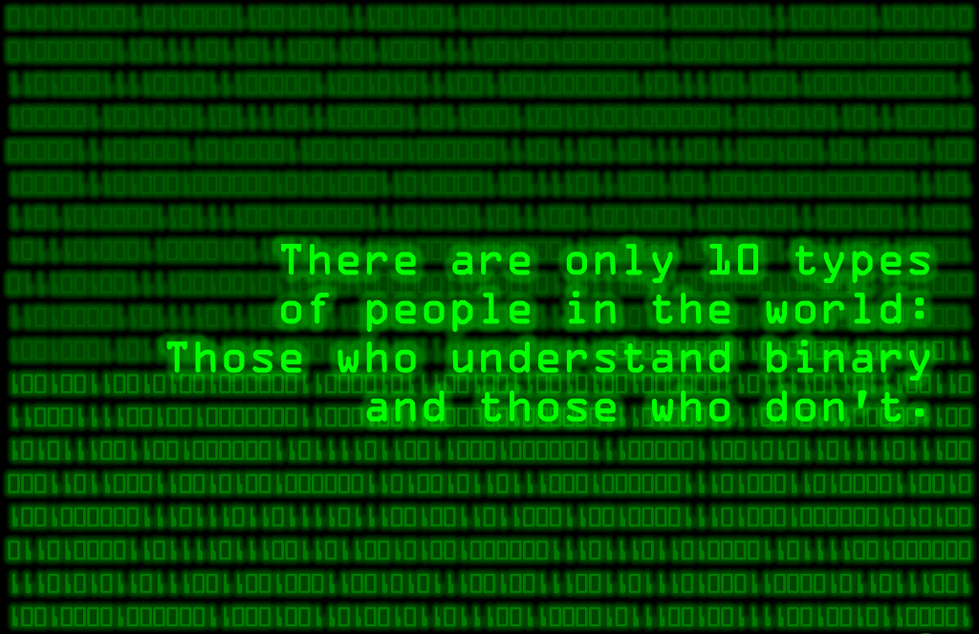

Biomedical Informatics
@ emory.edu
BMI 500

Slide 2
Informatics
“A discipline that is focused on acquisition, storage, and use of information in a specific setting or domain” — Hersh 2009
Emphasize how to become effective consumers of information
Domain
Technology
Information
Data
Notes:
Domains produce data
Technology provides new ways to examine and integrate data
From this data, information is extracted
This information allows you to ask questions, formulate hypothesis and subsequently impact the domain
Which will now produce a richer set of data
The goal is to enable science to do things it could not do before, ask questions that could not be asked
It is not just the technology

Slide 3
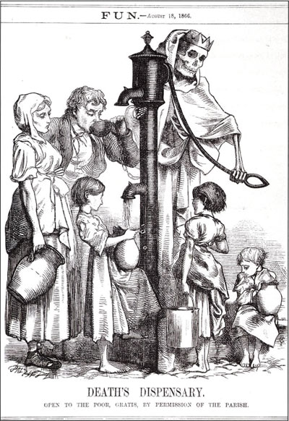
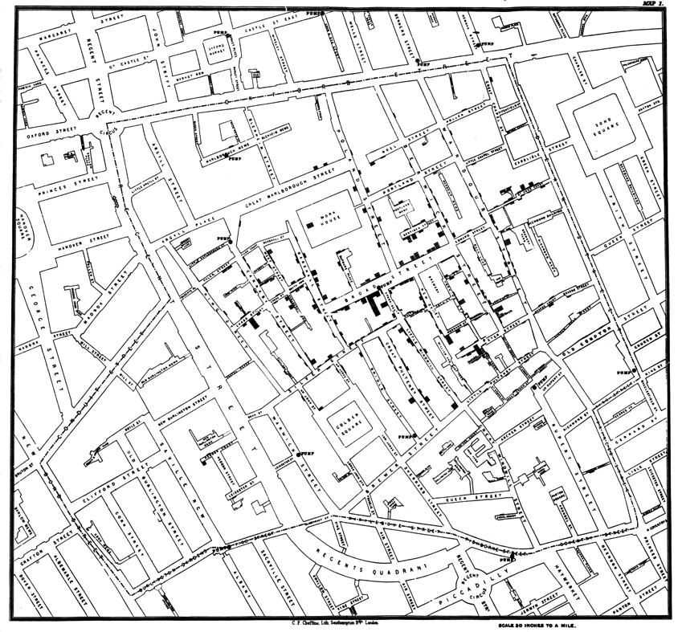
Early example of informatics
John Snow & the cholera map
1854 Cholera epidemic in London
Notes:
This is where information visualization comes in.
Some of you might know this but one of the earliest instances of using information visualization was during the Cholera epidemic of 1854.
Foul air was suspected to be the main culprit.
However an anesthesiologist, by the name of John Snow, suspected that water might be behind the outbreak.
SO he plotted a map of places where there were outbreaks and overlayed maps of water pumps.
Turns out he was right. City officials removed pump handles and the outbreak started to subside.
So while, my description is bit of an oversimplification — the central message is not. Informatics can be a powerful tool that allows us to explore data and extract Information

Slide 4
Biomedical Informatics
BMI is a heterogeneous field that brings together clinicians, researchers from both life sciences and physical sciences, and engineers
BMI training allows you to become better consumers of information gathered in:
Hospitals and Healthcare Practice
Biological and Clinical Research
…
while advancing computer science and other cross-cutting disciplines.
You don’t necessarily “train” in BMI, as much as get experience in applying informatics techniques in biomedical and/or clinical domains

Slide 5
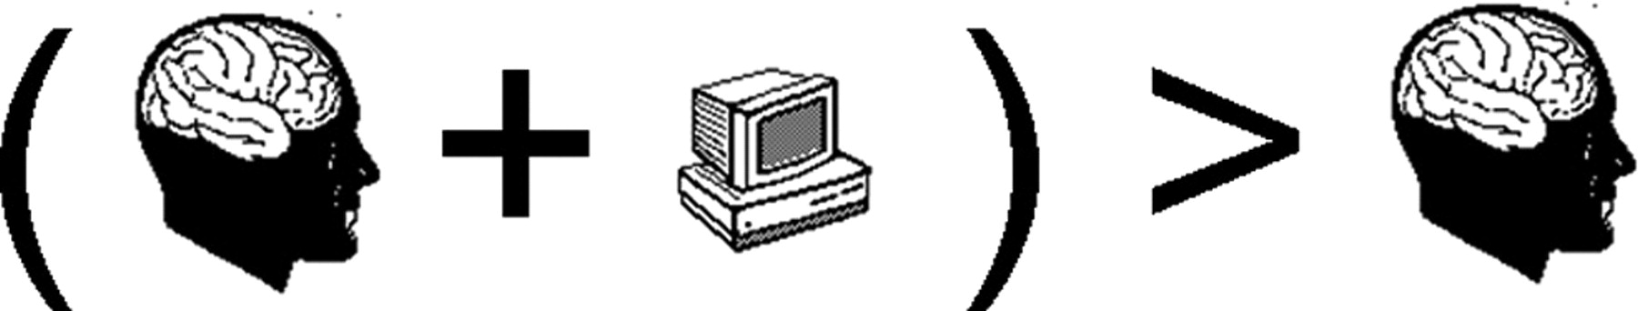
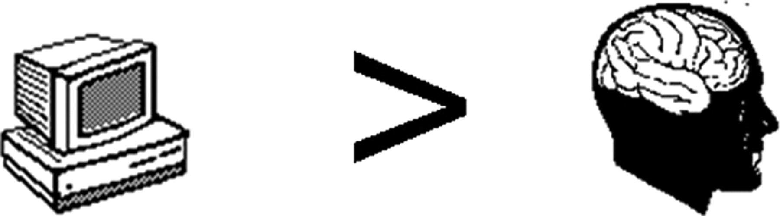
Fundamental Theorem of Biomedical Informatics*
“A person working in partnership with an information resource is ‘better’ than that same person unassisted.”
In order for the theorem to hold, the resource must offer something that the person does not already know
Whether the theorem holds depends on an interaction between person and resource, the results of which cannot be predicted in advance
Informatics is:
Informatics is not:
* Friedman C P J Am Med Inform Assoc 2009;16:169-170
Notes:
The metaphoric “person” depicted in the theorem can be a clinician, a scientist, a student, a patient or an administrator.
The “person” can also be a team or group, or even an organization.
The “information resource” is any mechanism capable of providing information or knowledge or advice to support the person's completion of a task. Information resources are usually, but do not have to be, computer-based
USABILITY MATTERS

Slide 6
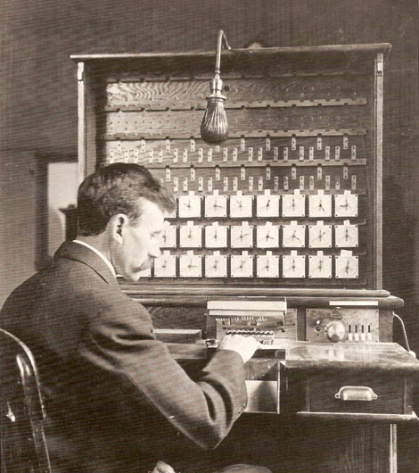
BMI & Technological Advances
1890: Herman Hollerith. Punch Cards data processing for US Census leading to mature public health and epidemiological surveys (1920 – 1940s)
1950 – 60s: Decision support & Hospital Information Systems (solve pressing information management problems).. E.g. MEDINET
1970s: Minicomputers that could be collocated with physicians or point-of-care — more manageable goals
Notes:
Medinet: A GE Subsidiary that had a very ambitious goal of a time sharing system, a total HIS, new language, global file system.

Slide 7
Biomedical Informatics in Perspective
Contribute to...
Biomedical Informatics Methods, Techniques, and Theories
Other
Component
Sciences
Management
Sciences
Information
Sciences
Computer
Science
Decision
Science
Cognitive
Science
Helps drive …
Contributes to….
Clinical or Biomedical Domain of Interest
Applied Informatics
Helps motivate
and drive …
© AMIA 2011
Notes:
Application of tools from the informatics toolbox contributes to Clinical and Bio domains
As domains advance they motivate and drive informatics techniques
One the cross-cutting sciences, fields such as CS help build BMI toolbox (eg. Security, HPC)
The BMI needs from various disciplines, in turn contribute and motivate CS

Slide 8
Interdisciplinary Nature of Biomedical Informatics
Computer Science (hardware)
Computer Science (software)
Cognitive Science
& Decision Making
Bioengineering
Biomedical
Informatics
Management
Sciences
Epidemiology
And Statistics
Clinical
Sciences
Basic Biomedical
Sciences

Slide 9
Primary BMI Domains of Interest
Bioinformatics: Store, analyze and mine biomedical and genomic data. Integrate multiple data modalities to advance our understanding of biological processes.
Clinical Informatics: Application of informatics for clinical care. e.g. Effective use of hospital records to improve quality
Imaging Informatics: Quantitative and reproducible interpretation, storage and structured representation.
Public Health Informatics: Usually limited to development of interoperable systems for adverse reaction registries, biosurveillance etc.
Consumer Health Informatics: Patient focused informatics, health literacy, communication sciences etc.

Slide 10
Overview
BMI is a heterogeneous field that brings together clinicians, researchers from both life sciences and physical sciences, and engineers
BMI training allows you to become better consumers of information gathered in:
Hospitals and Healthcare Practice
Biological and Clinical Research
…
while advancing computer science and other cross-cutting disciplines.
You don’t necessarily “train” in BMI, as much as get experience in applying informatics techniques in biomedical and/or clinical domains
Notes:
BMI is more about information than technology.
BMI can help drive technology development
But the emphasis is on application

Slide 11
Biomedical Informatics
Biomedical informatics (BMI) is the interdisciplinary field that studies and pursues the effective uses of biomedical data, information, and knowledge for scientific inquiry, problem solving, and decision making, motivated by efforts to improve human health.

Slide 12
Biomedical Informatics: Corollaries to the Definition
BMI develops, studies and applies theories, methods and processes for the generation, storage, retrieval, use, and sharing of biomedical data, information, and knowledge.
BMI builds on computing, communication and information sciences and technologies and their application in biomedicine.

Slide 13
Biomedical Informatics: Corollaries to the Definition
BMI investigates and supports reasoning, modeling, simulation, experimentation and translation across the spectrum from molecules to populations, dealing with a variety of biological systems, bridging basic and clinical research and practice, and the healthcare enterprise.
BMI, recognizing that people are the ultimate users of biomedical information, draws upon the social and behavioral sciences to inform the design and evaluation of technical solutions and the evolution of complex economic, ethical, social, educational, and organizational systems.

Slide 14
Biomedical Informatics in Perspective
Basic Research
Biomedical Informatics Methods, Techniques, and Theories
Bioinformatics
Imaging Informatics
Clinical
Informatics
Public Health Informatics
Applied Research
And Practice
© AMIA 2011

Slide 15
Biomedical Informatics in Perspective
Basic Research
Biomedical Informatics Methods, Techniques, and Theories
Consumer Health
Pharmaco- genomics
Biomolecular
Imaging
Bioinformatics
Imaging Informatics
Clinical Informatics
Public Health Informatics
Applied Research
And Practice
Continuum with “Fuzzy” Boundaries
Molecular and
Cellular
Processes
Tissues and
Organs
Individuals
(Patients)
Populations
And Society
© AMIA 2011

Slide 16
Informatics in Action: Response Assessment, Outcome Prediction, and Adaptive Therapies

Slide 17
Multidisciplinary Team
Radiology
James Provenzale
Chad Holder
Scott Hwang
Neuro-oncology and Radiation Oncology
Ian Crocker
Hui-Kuo Shu
Walter Curran
David Reardon
(Dana Farber Cancer Institute)
Medical Physics
Tim Fox
Eduard Schreibmann
Informatics and Biostatistics
Ashish Sharma
DuBois Bowman
Joel Saltz
Walter Bosch
(Washington University, St. Louis)

Slide 18
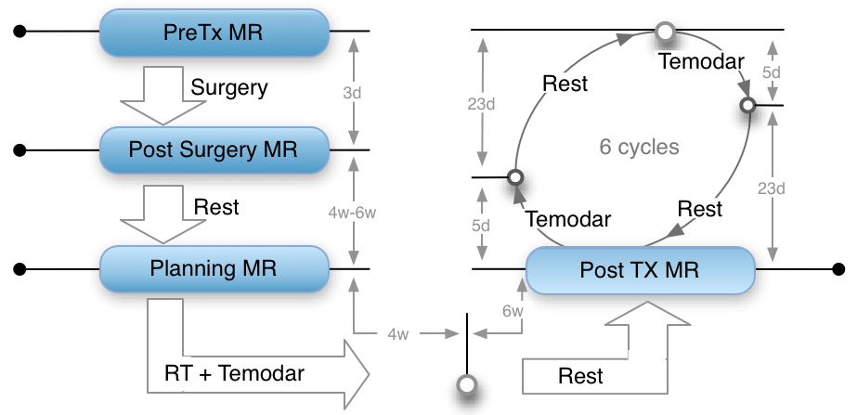
Glioblastoma Multiforme (GBM)
Most common and most aggressive brain tumor in adults
Standard treatment protocol (Stupp* Regimen) involves a combination of Surgery, Chemotherapy and Radiation Therapy
Stupp, R. et al. “Radiotherapy plus Concomitant and Adjuvant Temozolomide for Glioblastoma”, New England Journal of Medicine, 2005, 352, (10), pp. 987-996

Slide 19
Imaging Informatics to
Novel ways to combine information derived from radiology, radiation oncology and clinical data to assess response and predict outcome.
Use response assessments and outcome predictions to evaluate and adapt therapy (radiation therapy & surgery)

Slide 20
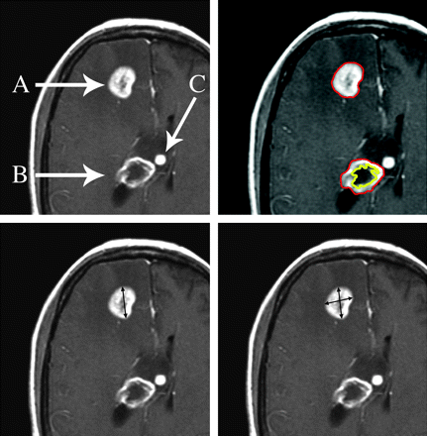
Response Evaluation: McDonald Criteria
After treatment (Surgery → Radiation → Chemo), how do you determine if tumor is responding to treatment?
A measurement is made of the maximal enhancing tumor diameter on a single axial gadolinium-enhanced T1-weighted section
Largest perpendicular diameter is measured on the same image.
Product of the 2 diameters is calculated,
Measurements are repeated with each scan.
Measurements from multiple lesions are summed.
Henson JW, Ulmer S, Harris GJ. Brain tumor imaging in clinical trials. AJNR Am J Neuroradiol. 2008;29(3):419-424.
Notes:
Current technique for treatment assessment in GBM patient

Slide 21
Used as a Clinical Decision Point
Post surgery, patients are monitored with MR and treatment is evaluated with the McDonald Criteria
Some patients show new areas of contrast enhancement (tumor worsening) despite an absence of any clinical symptoms → Pseudo Progression (PSP)
~20% of treated patients
Possibly cause: increased vessel permeability and subsequent edema from RT+Chemo
Not correlated with worsening outcome
Causes oncologists to change therapy
Survival has been shown to increase with alternative methods of radiotherapy or by adding addition treatments such as chemotherapy drugs
Notes:
It’s however not the only decision point as far as assessment is concerned, i.e. a tumor is assessed not only as PSP vs TP. It could also be rapidly improving…

Slide 22
How can we improve this?
Quantitative, not qualitative assessment
Leverage advanced imaging (Diffusion weighted MR imaging, Perfusion MR)
Combine Imaging with Radiation Therapy Data

Slide 23
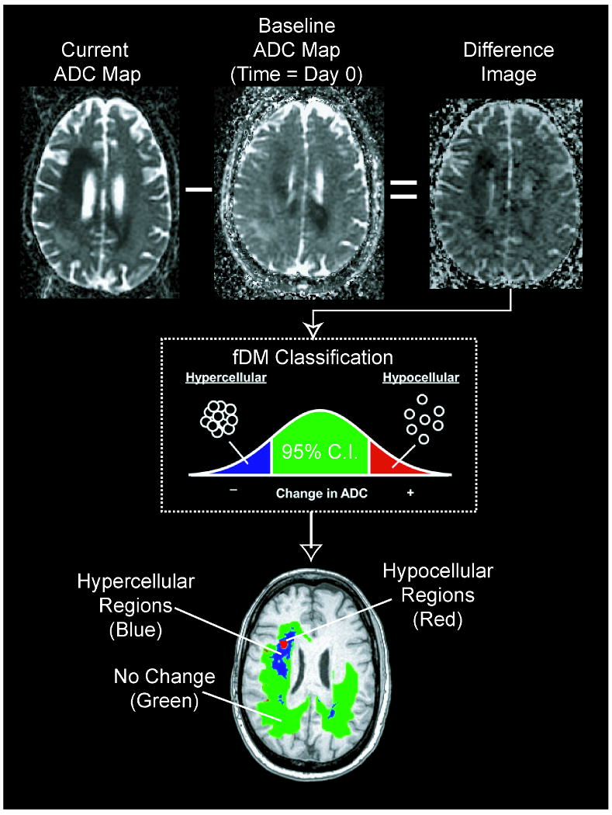
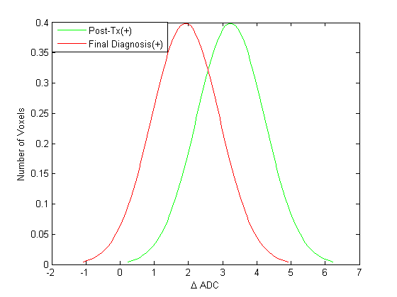
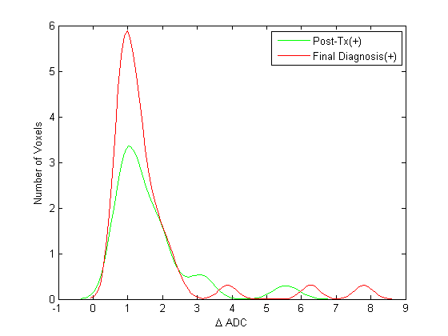
1. Use Advanced Imaging Diffusion Weighted Magnetic Resonance Imaging
Measure changes in ADC value within tumors on a voxel-by-voxel basis
Low ADC values have been correlated with high cell density
high cell density is seen in tumor progression
elevated ADC values → beneficial treatment response
Figure: B.M. Ellingson et al. (2010). Validation of functional diffusion maps (fDMs) as a biomarker for human glioma cellularity. Journal of Magnetic Resonance Imaging, 31(3), 538–548.
Notes:
the distributions of changes in ADC values from baseline to two time points, namely one month post-treatment and time of final diagnosis (approximately 3 months).
patients experiencing true progression reveal a downward shift reflecting decreased ADC values at the time of final diagnosis, relative to the first postoperative scan (Post-Tx) (see Figure 5, subject 1).

Slide 24
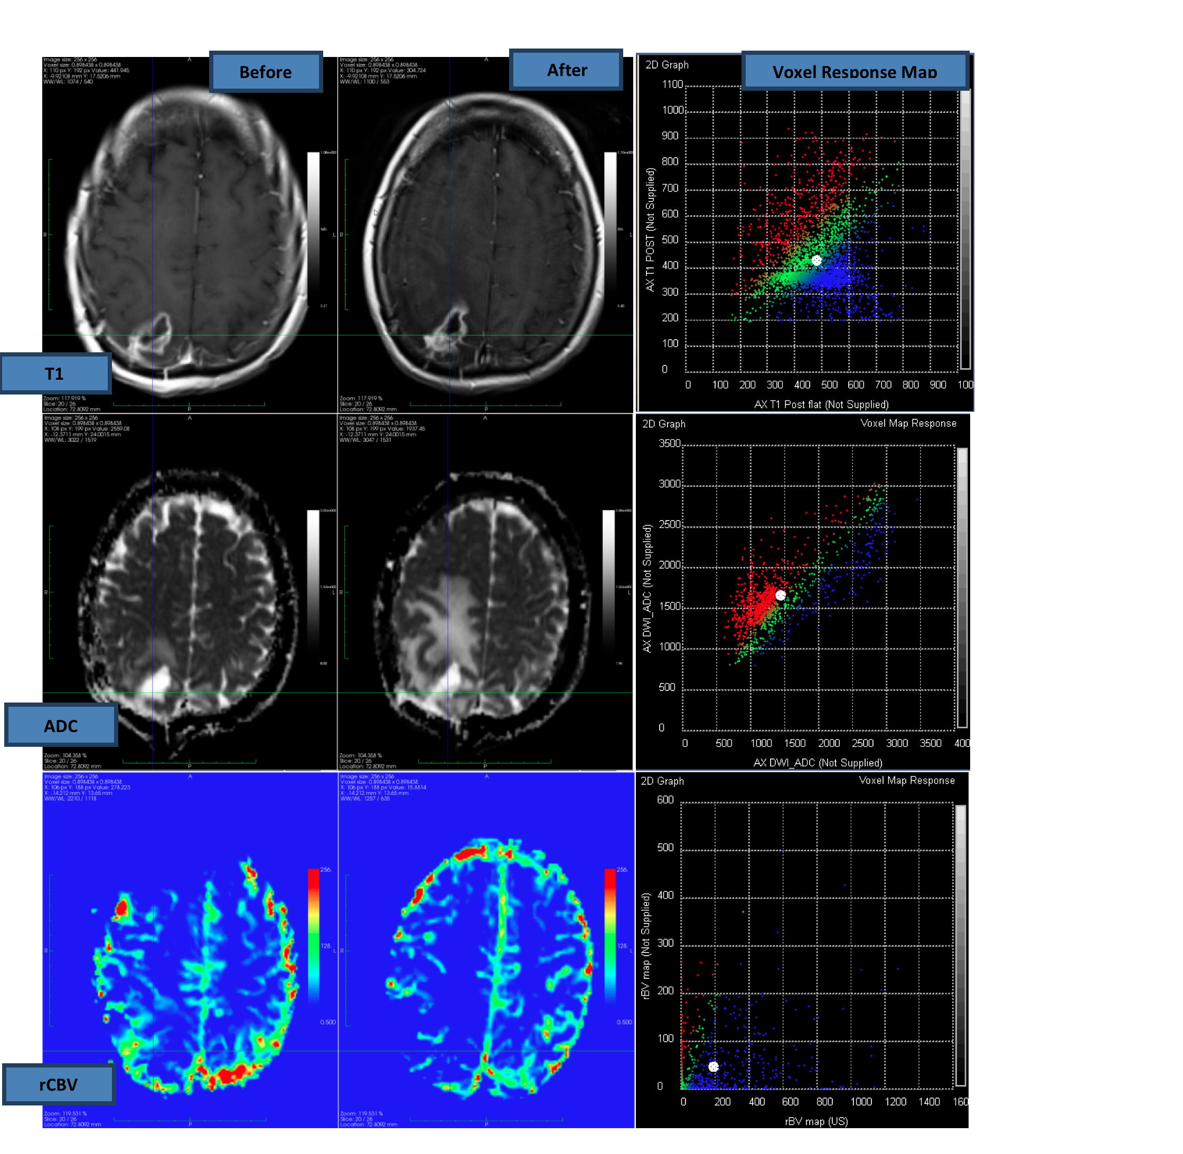
2. Combine Imaging Modalities Diffusion Weighted Magnetic Resonance Imaging
Imaging of pre (left) and post (right) enhancement.
T1 imaging (upper row) shows an enhancing lesion in both datasets
ADC (middle row) shows increase in diffusion
rCBV (lower row) shows a decrease in blood volume
ADC & rCBV characteristics consistent with PSP
graphs in right column are used to measure voxel-by-voxel changes and are color-coded into increase (red), no change(green) and decrease (blue)

Slide 25
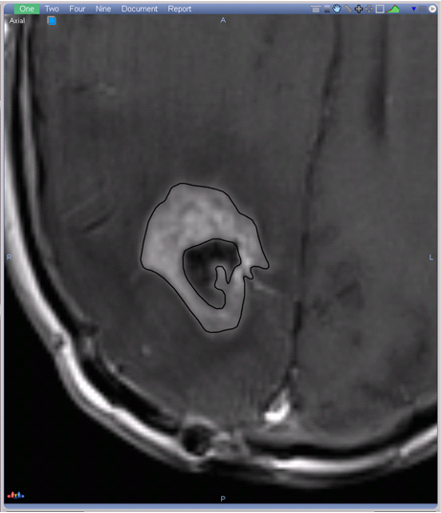
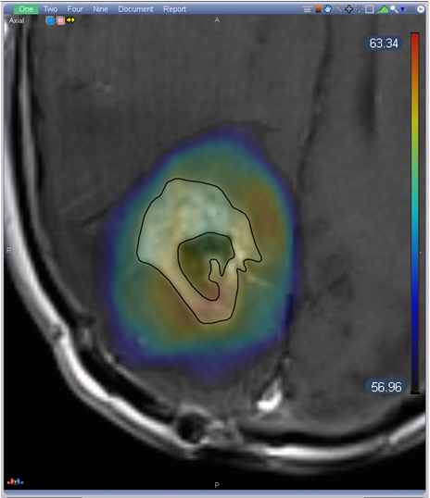
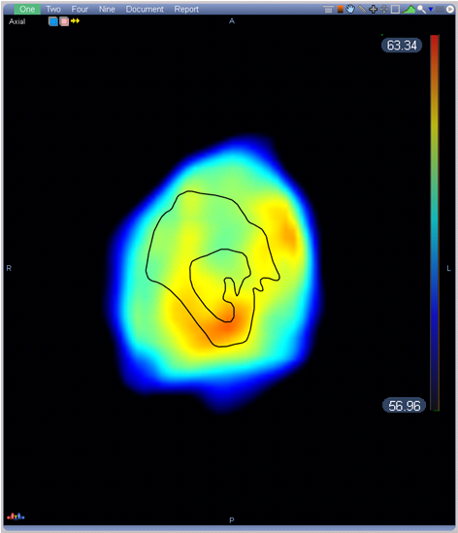
Dose & RT Integration
Dose delivered during treatment is correlated with the T1-weighted images
Co-registered images
Correlate dose at specific sites to regions of new contrast-enhancement
better understand why regions of new contrast-enhancement due to pseudo- progression are dose-related
Retrospectively determine the perfusion and diffusion characteristics that develop contrast-enhancement consistent with PSP
Prospectively assign slightly different RT doses regions of tumor
Dose correlated with the enhancing MRI.
4 month post-RT MR shows that the dose given to the area is higher and hotter than for the other areas, consistent with the idea of partial tissue necrosis in pseudo-progression

Slide 26
Treatment and Response Assessment
Planning CT & Radiation Treatment Plan
1 month follow up
3 month follow up
6 month follow up

Slide 27
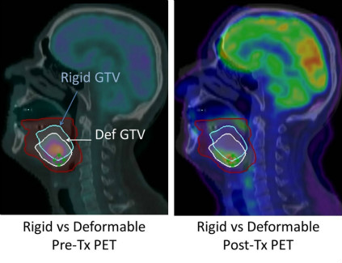
Challenges with combining data from multiple time points
From Velocity Medical Solutions: http://www.velocitymedical.com/head-and-neck-case-study.htm
Notes:
Image on left shows PET GTV on initial CT Sim using rigid or deformable image registration. Image on right is follow-up PET scan which shows a marginal recurrence due to use of rigid registration.

Slide 28
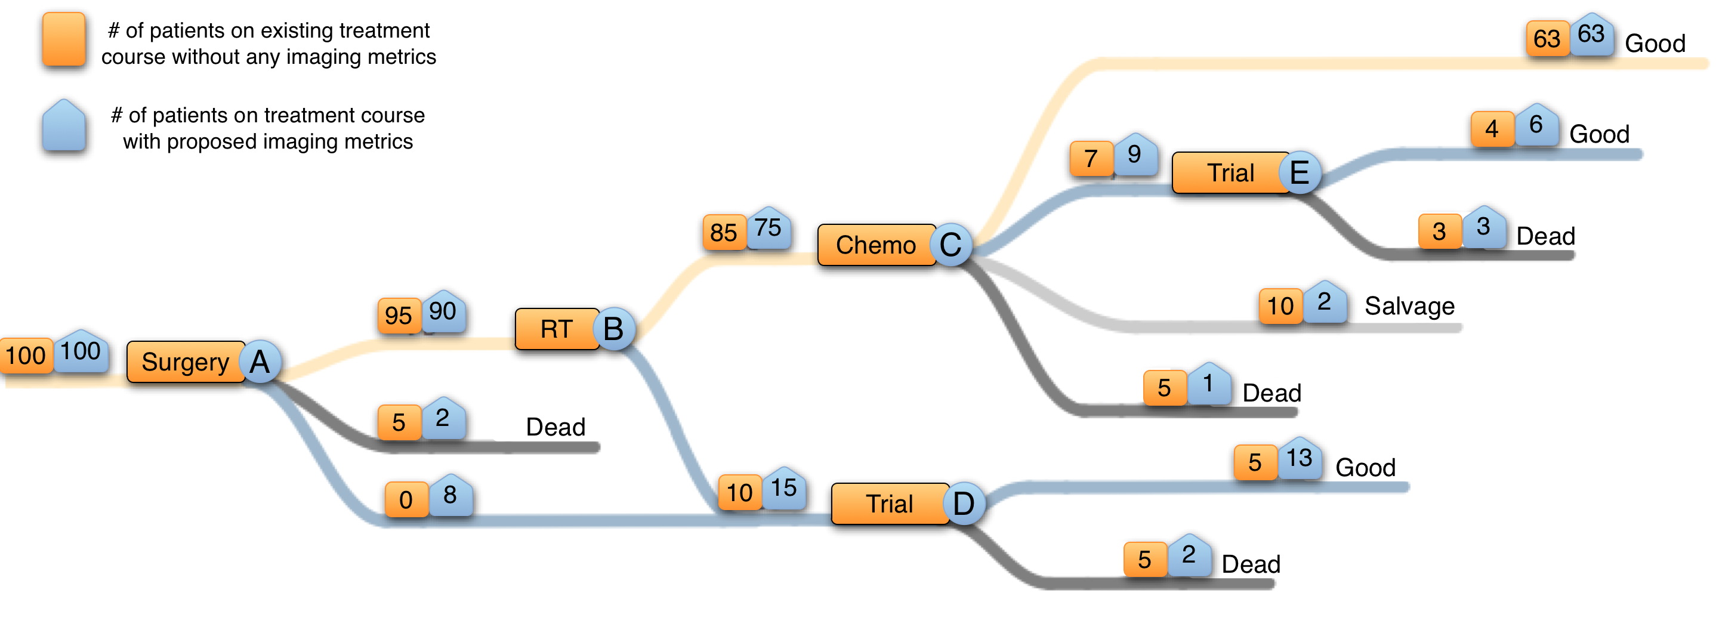
Imaging Informatics to
Novel ways to combine information derived from radiology, radiation oncology and clinical data to assess response and predict outcome.
Use response assessments and outcome predictions to evaluate and adapt therapy (radiation therapy & surgery)

Slide 29
Expectations
At the end of the semester you won’t:
Become better programmers
Learn to fix PACS, RIS, EMRs etc.
However you will:
Learn to become consumers of healthcare information
Learn and appreciate the technological and informational complexities of biomedical research and clinical practice
Understand the broad concepts of biomedical informatics
Start future work in the application of informatics in specific domains (imaging, clinical, public health)

Slide 30
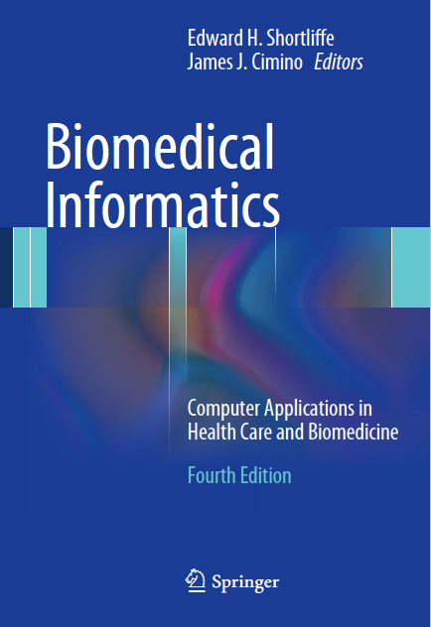
Course text
High level, and general / wide reaching
No need to purchase, Emory libraries has version online.

Slide 31

Questions & Homework
Pick one of the six question from the end of Ch2 in Shortliffe and write a 0.8-1 page answer
Email pdf to ashish.sharma@emory.edu by Friday 5pm before next class – i.e. 9th Sept.
(There’s no class next week – it’s memorial day)

Slide 32
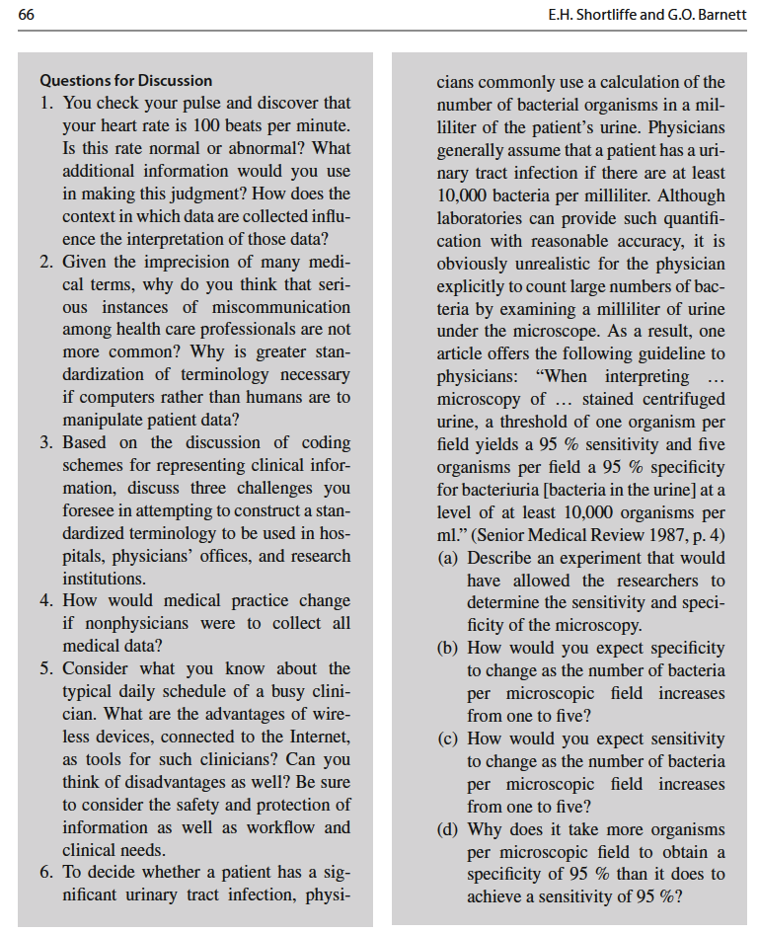
Chapter 2 Questions

Slide 33
Grading – recap!
Each week you will be graded /10
Final mark is average of all grades
No properly excused absence (e.g. job interview or family illness) = 0 for the week
Leaving early or arriving late = -2
Handing in late = -1 for each day or part of day that passes
Partial credit for partially completed assignments
No credit for corrupt PDFs
We won’t be chasing you
No excuse for not achieving 90-100%
Notes:
Gari

